Slide 1


Analysis of Airbnb Data Using Power BI Created by – Ajin K.Biju

Slide 2

Assessing District Location Scores

Slide 3
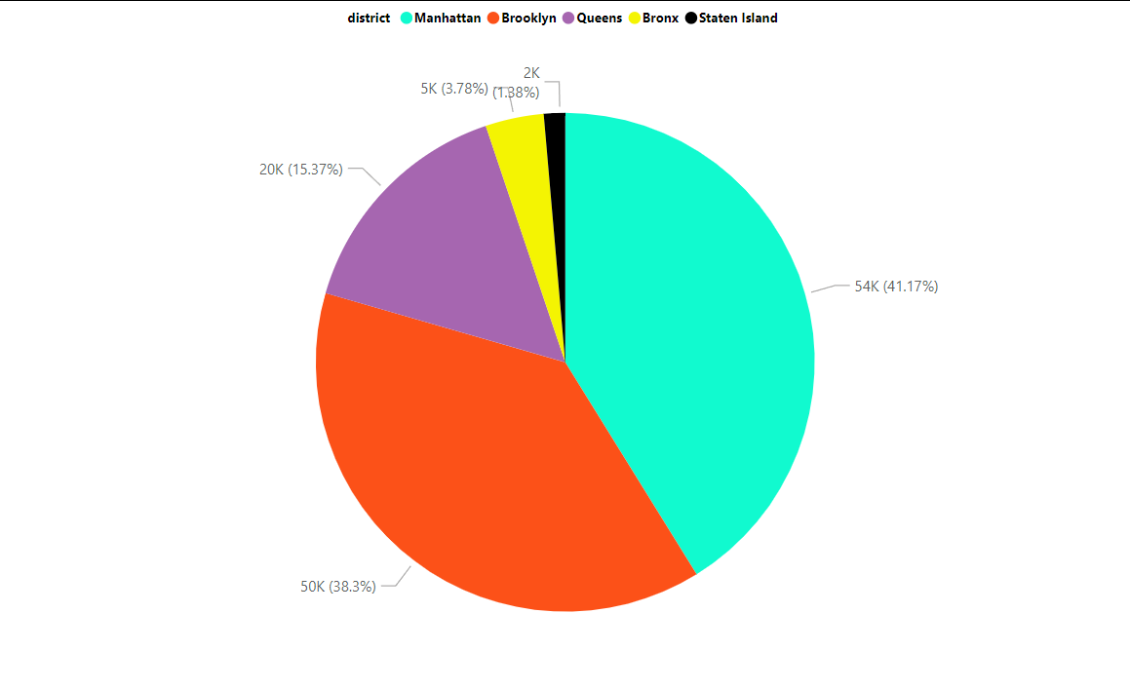
Manhattan (Aqua): 54K, representing 41.17% of the total scores. This is the largest segment.
Brooklyn (Orange): 50K, representing 38.3% of the total scores. This is the second largest segment.
Queens (Purple): 20K, representing 15.37% of the total scores.
Bronx (Yellow): 5K, representing 3.78% of the total scores.
Staten Island (Black): 2K, representing 1.88% of the total scores.

Slide 4
Examining Host Response Time Impact

Slide 5
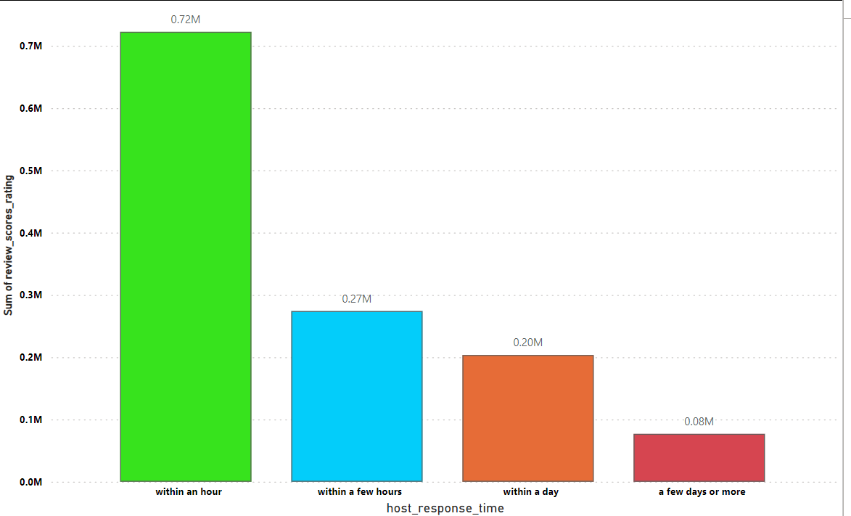
Immediate Response Matters:-
Hosts who respond within an hour see significantly higher review scores, with a total of 0.72M. This suggests that quick responses are crucial for maintaining high ratings.
Gradual Decline with Delay:-
As the response time increases, the sum of review scores decreases. Responding within a few hours still yields good scores (0.27M), but this is notably lower than immediate responses.
Day and Beyond:-
Hosts who take a day or more to respond see further drops in their review scores, with those responding within a day achieving 0.20M and those taking a few days or more only achieving 0.08M.

Slide 6

Visualizing Airbnb Listing Prices

Slide 7
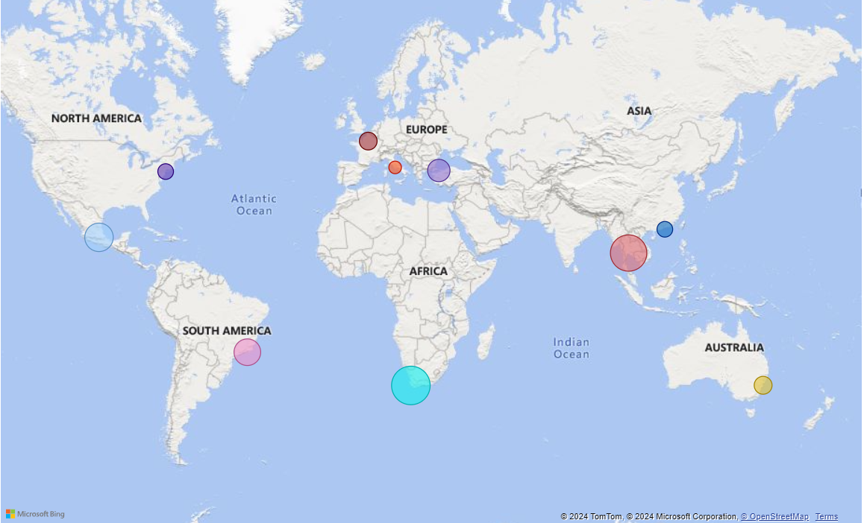
High concentrations of higher Airbnb listing prices are observed in Southeast Asia and Southern Africa,
Moderately high prices in Central and Western Europe, and relatively lower prices in North and South America
Australia showing moderate pricing levels due to its unique tourism market.

Slide 8

Analyzing Composite Scores

Slide 9
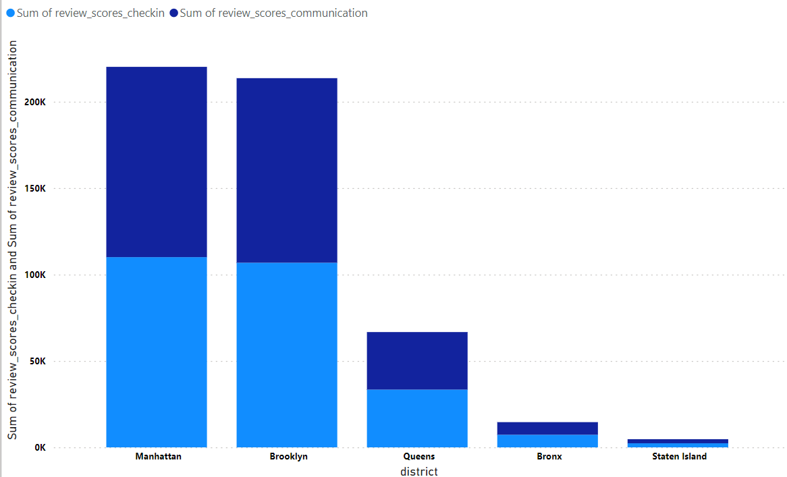
Manhattan and Brooklyn lead in check-in and communication scores,
While Queens, Bronx and Staten Island lag, suggesting potential improvement areas.

Slide 10

Calculating Listing Age and Host Tenure

Slide 11
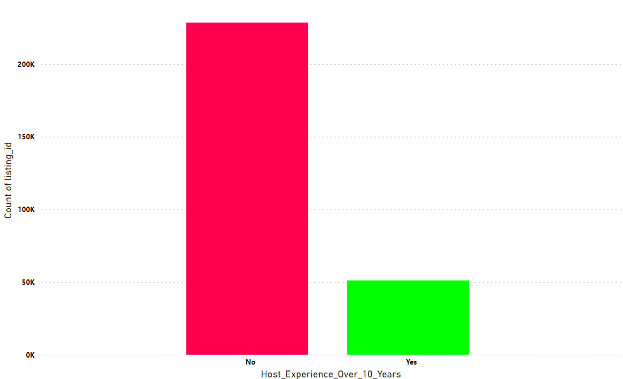
The platform has a significantly larger number of new hosts compared to experienced ones, indicating a potential experience gap.

Slide 12

Property Type Price Analysis:

Slide 13
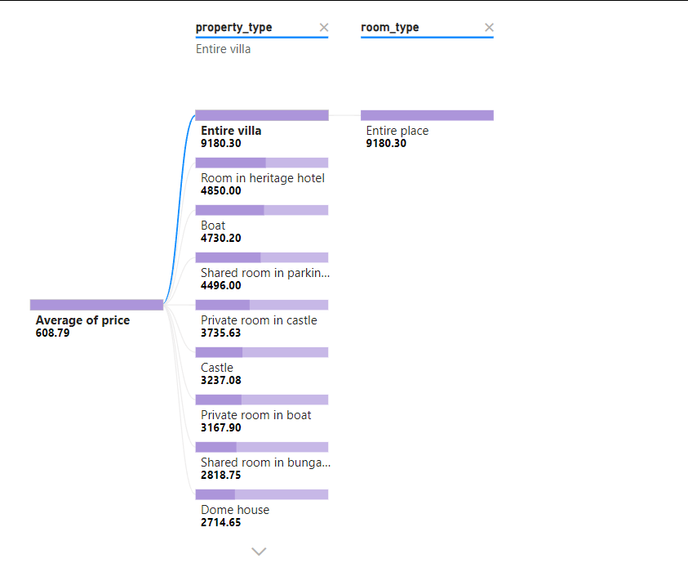
The image reveals a hierarchy of accommodation types based on average price. Entire villas and places are the most expensive, followed by heritage hotels. Boats and shared rooms occupy the middle range, while castles, private rooms in boats, and shared bungalow rooms are the most budget-friendly options.

Slide 14

Crafting a Comprehensive City Insights Report

Slide 15
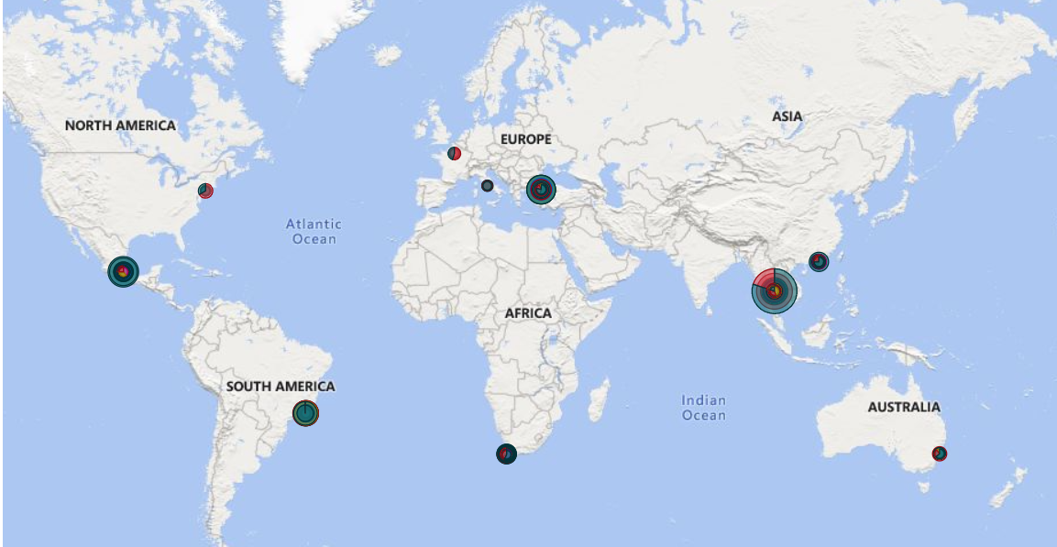

Slide 16


